Slide 1
Association between S antibody levels to COVID-19 infection status and symptom level from nationwide community surveillance data in South Korea
Zhang, Franky
Jo, Youngji

Slide 2
Background
Previous studies identified that neutralizing antibody levels are highly predictive of immune protection from symptomatic SARS-CoV-2 infection (Khoury DS et al, 2021) and the levels of antibody protection required to prevent symptomatic COVID-19 (Feng S et al, 2021)
Neutralizing Antibodies: The S antibodies include neutralizing antibodies, which can directly interfere with the ability of the virus to infect cells. Higher levels of S antibodies generally correlate with a stronger capacity to neutralize the virus and prevent infection.
Vaccine Efficacy: COVID-19 vaccine efficacy is linked to strong S antibody responses. Vaccines with higher S antibody titers are generally more effective in preventing or lessening COVID-19 severity.
Duration of Protection: S antibody protection duration is being studied. Although S antibodies offer initial defense, their levels may decrease over time, reducing protection. This has prompted booster shot recommendations to sustain immunity..
Variants of Concern: The rise of SARS-CoV-2 variants has complicated how S antibody levels protect us. Variants with mutations in the S protein can lower antibody effectiveness, risking breakthrough infections in vaccinated people. Research continues to explore the protection correlation against various variants..
Measurement and Interpretation: Quantitative S antibody level assessments offer insights into immune status, but the protective threshold varies and isn't precisely defined for the population.
Notes:
As of December 2022, South Korea achieved a vaccination coverage of 86.43% for at least one dose ^{[1]}.
It's important to note that the immune system's protection against COVID-19 is not solely dependent on S antibodies. Other components of the immune system, including T cells, also play crucial roles in responding to infection and providing long-term immunity. Continuous research is essential for a deeper understanding of the protective mechanisms against SARS-CoV-2 and for optimizing vaccination strategies.

Slide 3
Objective
Repeatable Community-Based Antibody Surveys
Lack of representative community-based seroprevalence data (most other studies are hospital-based with relatively small sample size)
Challenges in assessing risk trends based on antibody titer variations through cross-sectional surveys
Examining the association between Spike (S) protein antibody levels and COVID-19 infection and the severity of COVID-19 symptoms
Notes:
The S protein is a structural protein on the surface of the virus that facilitates its entry into human cells. Vaccines that target the S protein are designed to elicit an immune response specifically against this protein. Here’s how the S antibody level is associated with protection against COVID-19 infection:

Slide 4
Epidemic curve of COVID-19 in Korea (2020.1.20.~2023.4.20.)
Longitudinal cohort investigation with serial sampling of the same individual each time
4th peak
5th peak
6th peak
7th peak
Community-based seroprevalence survey of COVID-19 in Korea
1st peak
2nd peak
3rd peak
Follow-up survey

Slide 5
Methodology
N+
Hybrid immunity
S+
10,000
Subjects
N-
Vaccine Induced
Surveillance Period: 1st survey: August 2022 2nd survey: December 2022 Surveillance Area: 258 cities and counties nationwide in South Korea 258 public health centers and 113 private medical facilities Surveillance Subjects: 10,000 individuals aged 5+ were randomly selected from 5,000 households. Surveillance method: Nationwide community-based surveillance. Surveyors conduct one-on-one interviews via tablets.
Outcome measurement: anti-Spike (S) antibody level and Group I: confirmation with infection between 1st and 2nd surveillance versus no infection Group II: confirmation with symptom versus non symptom
Statistical analysis: descriptive analysis, logistic regression, statistical inference
N+
Infection induced
S-
N-
Naive
Notes:
First say what is antibody, two type of antibodies. N+ means infection before. S+ means infection/vaccinated.

Slide 6
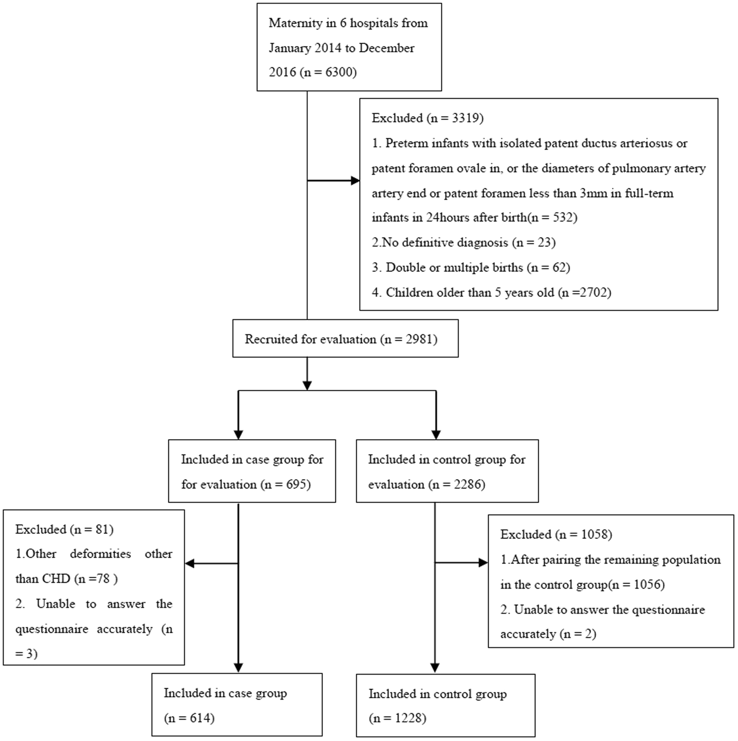
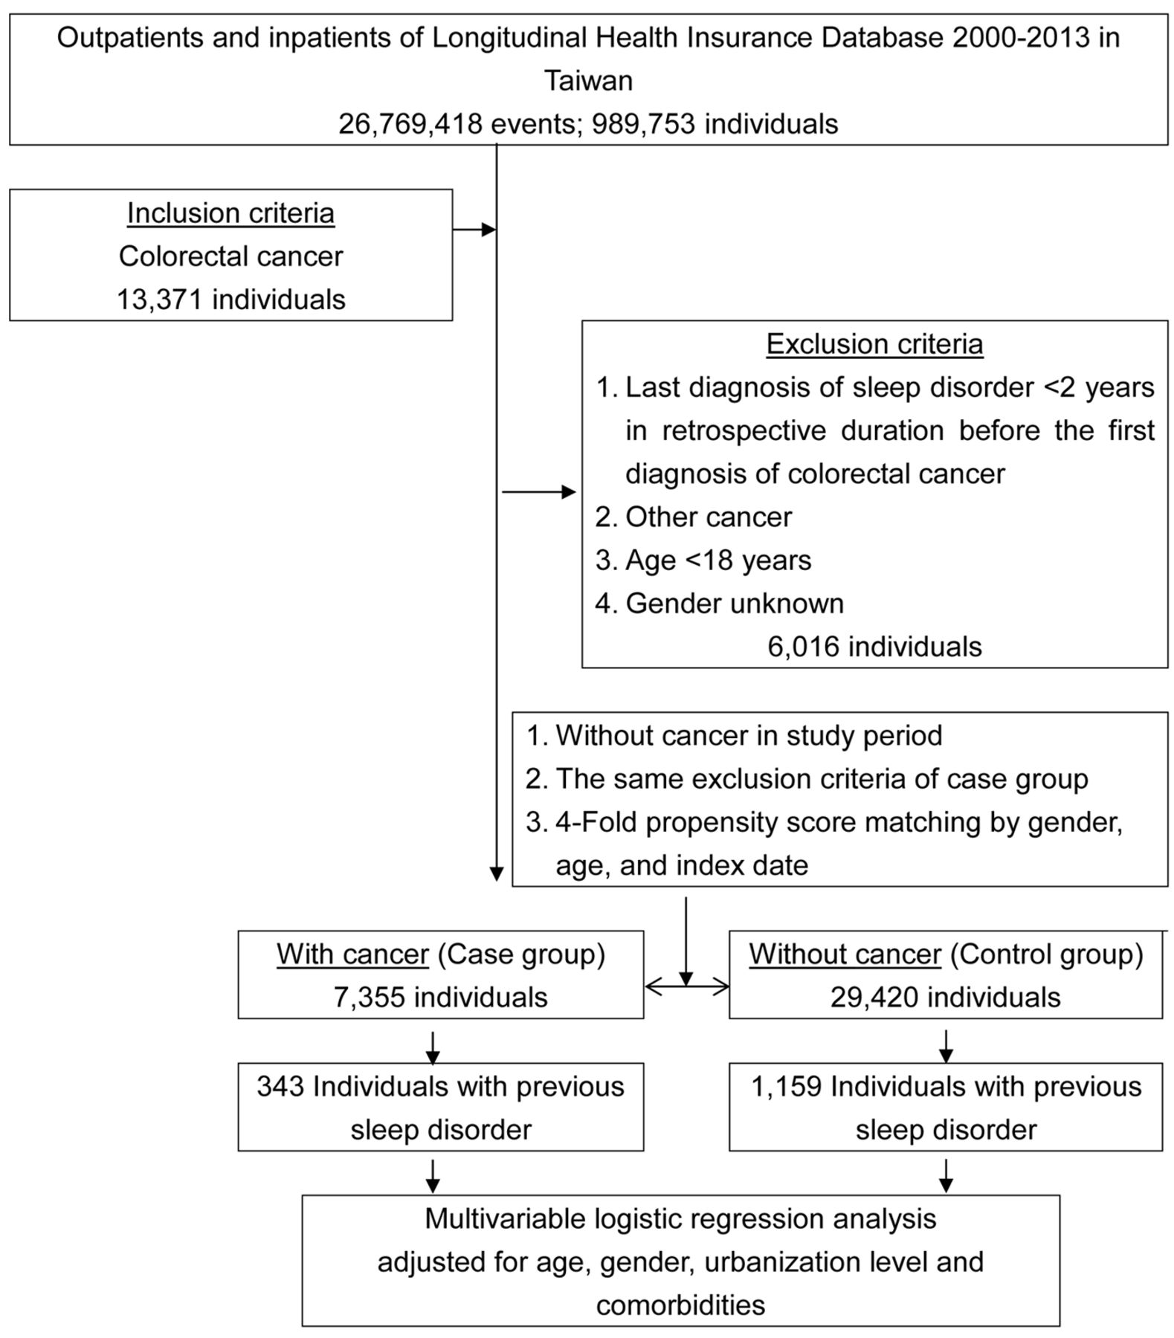

Slide 7
Specify the criteria
Who will be considered as confirmed infection:
Firstly, consider those who reported infection duration 1st and 2nd surveillance (n=766), however, only 690 of them have N_cha_S2 == “Reactive”. While the N antibody should only come from infection, they might be wrongly reported, and we label them as confirmed infection (n=544).
Secondly, consider those whose S antibody level increased but reported no infection. They might be infected but didn’t report. We label them as unconfirmed infection.
All the confirmed infection are included in our “infection vs non-infection” study as “cases”.
Now, looking for “controls”.
Firstly, those who reported infection during 1st and 2nd surveillance(n=766) and who are labelled as “unconfirmed infection”(n=544) should be excluded. Although we can not make sure they are all infected, we should exclude them anyway.
Secondly, those who didn’t attend 2nd surveillance should be excluded because they might have infections after 1st surveillance but didn’t report.
Additionally, those who have missing values at 1st or 2nd surveillance should be excluded since the next stage is based on S antibody level comparison.
Then, finally, those who didn’t have vaccination record but the S antibody level increased should be excluded.
Then, the rest of population can be considered as “controls” in our study.

Slide 8
Figure1: Flowchart to create cohorts with 1st and 2nd Survey data.
9,945
Total amount of objects in
the 1st surveillance
Without reported infection between 1st and 2nd Survey (n = 9,179)
With reported infection between 1st and 2nd Survey (n = 766)
Exclude those who did not attend or missing S antibody level in the 2nd survey (n = 2,423)
Exclude those had N- antibody at the 2nd Survey (n = 76)
Exclude the population with vaccination during 1st and 2nd Survey (n = 1,349)
Exclude those who had vaccination before confirmation (n = 22)
Exclude the population with increased S Antibody level in the 2nd survey (n = 1,207)
Included in the Case Group :
n = 668
Included in the Control Group:
n = 4200

Slide 9
Figure1: Flowchart to create cohorts with 1st and 2nd Survey data.
9,945
Total amount of objects in
the 1st surveillance
Exclude those who did not attend or missing S antibody level in the 2nd survey (n = XXX)
Exclude the population with vaccination before infection during 1st and 2nd Survey (n =XXX)
Unconfirmed infection: the population with increased S Antibody level in the 2nd survey (n = XXX)
No infection between 1st and 2nd Survey (n = 9,179)
Confirmed infection between 1st and 2nd Survey (n = 766)
Exclude the population with vaccination during 1st and 2nd Survey (n =XXX)
Exclude those had N- antibody at the 2nd Survey (n = 76)
Included in the Case Group :
n = XXX
Included in the Control Group:
n = XXX

Slide 10
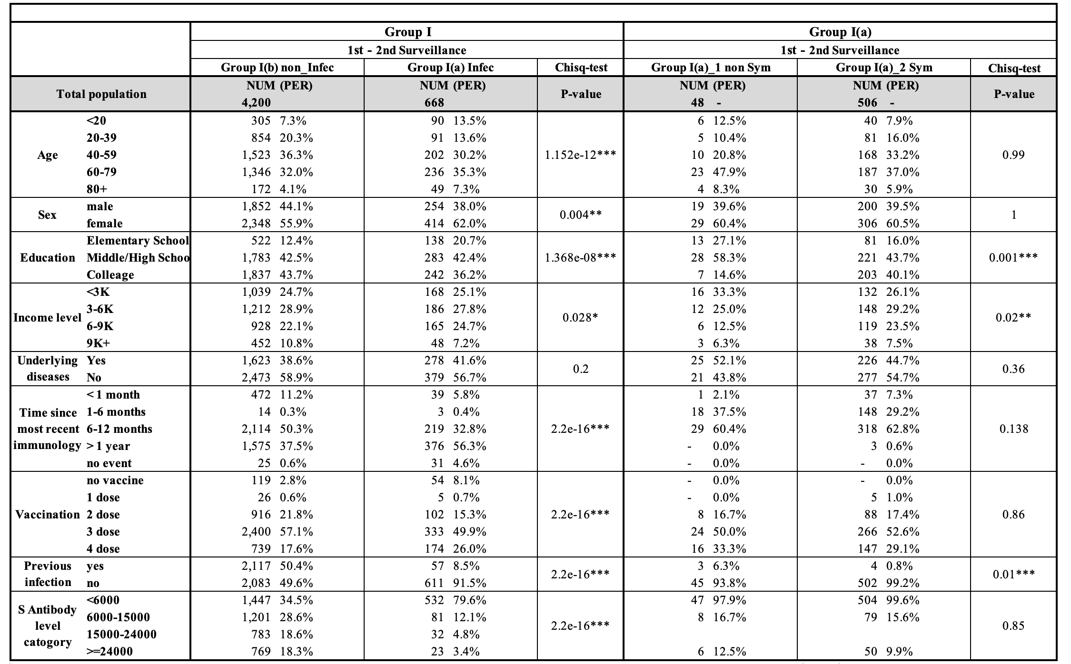
Table1: Description for case-based cohort
Add a total
Include hybrid, vaccine
Naïve induced
in the table
As well as the forest
plot

Slide 11
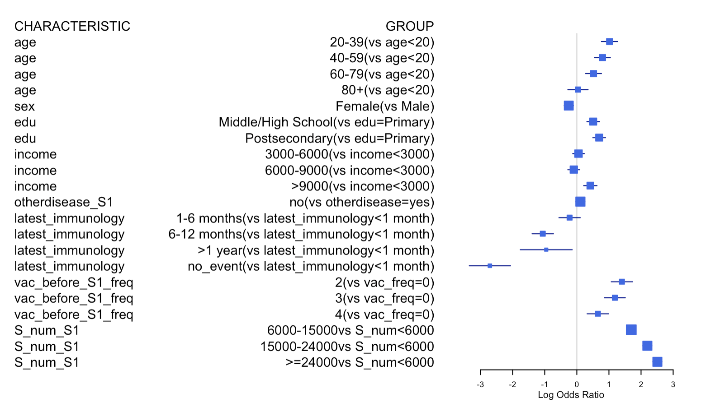
Change the value related to the risk(infection)

Slide 12
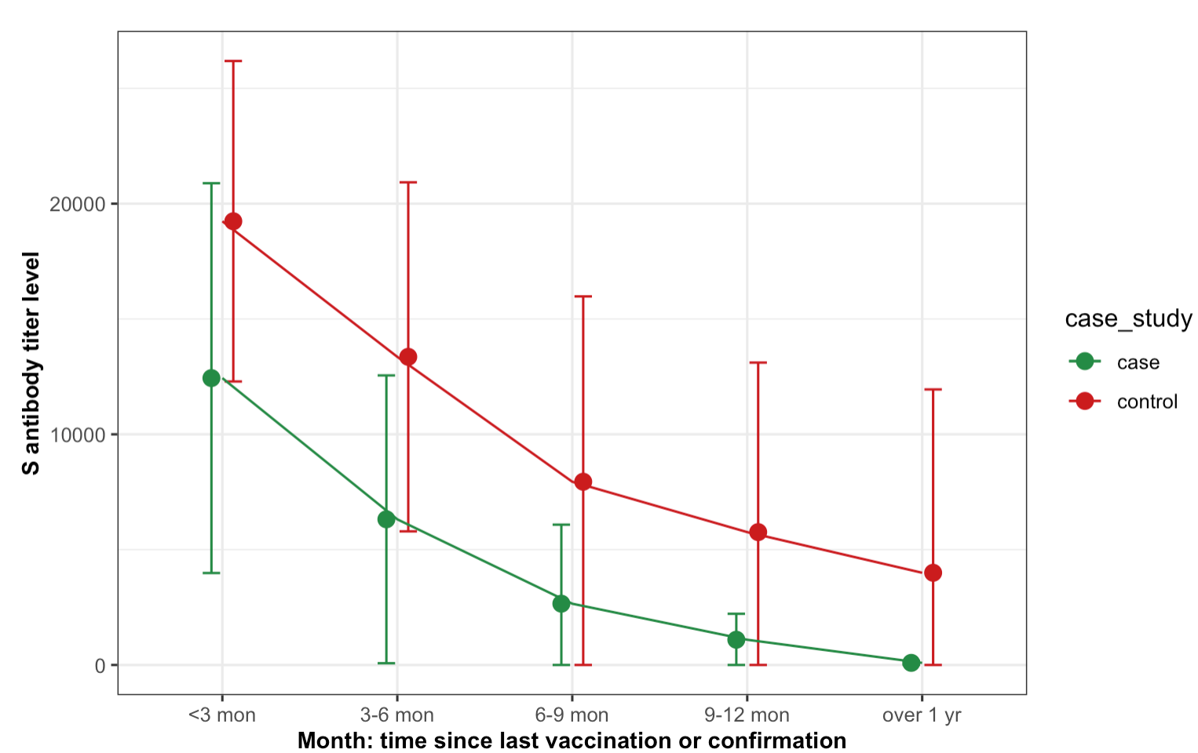

Slide 13
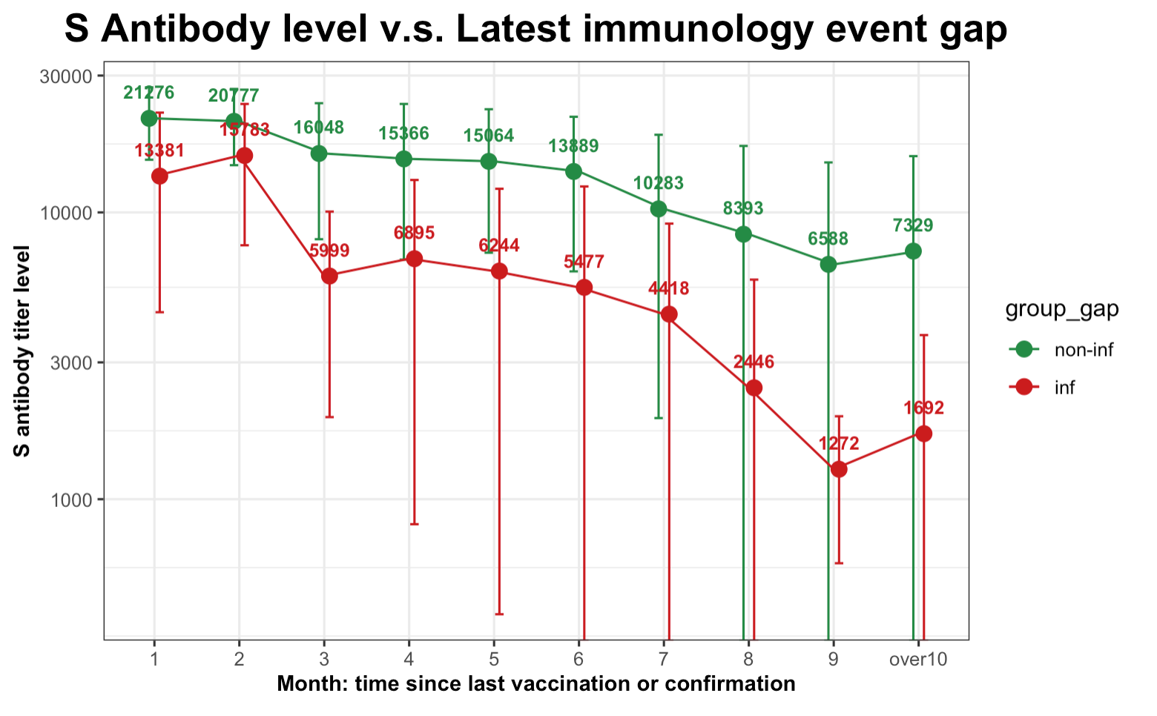
Figure2b: Line plot of S antibody levels versus latest immunological gap
10^{4.5}
Update the plot
10^{4.0}
10^{3.5}
10^{3.0}
Whatever the most recent immunological gap, the average S antibody level of objects without infection is obviously
higher than those with infection; Additionally, as the most recent immunological gap goes on, the median S antibody
level goes down
Notes:
Include another stratified analyses by age
Longre

Slide 14
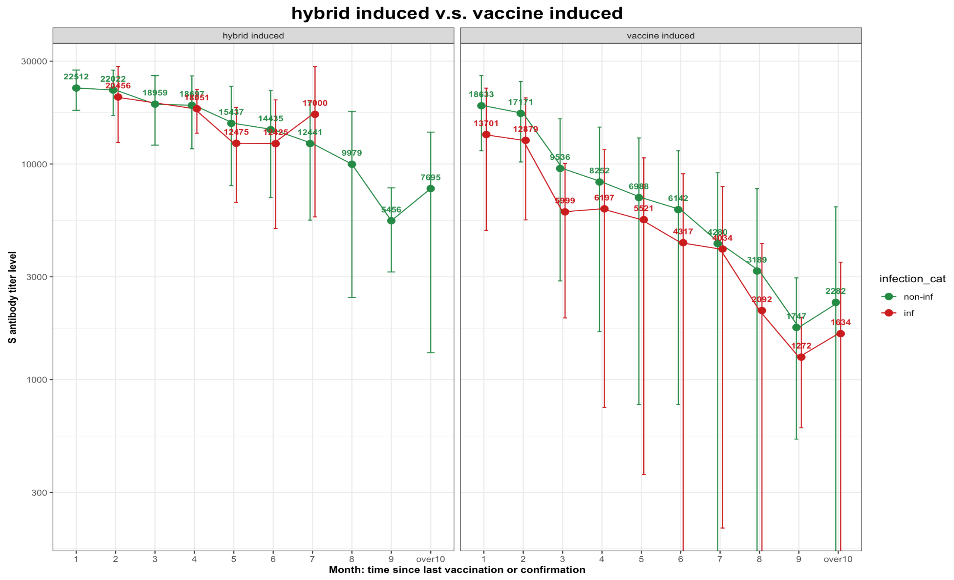
Figure2c: Line plot of S antibody levels versus latest immunological gap, grid wrapped by hybrid induced(A) and vaccine induced group(C)
10^{4.5}
Three panels
Total
Hybrid induce
Vaccine
…
10^{4.0}
10^{3.5}
10^{3.0}
10^{2.5}
Notes:
Draw this as survival curves…? Between hybrid vs vaccined induced group or age groups? Underlying diseaess?
OR by hybrid or not, age, S ab level , time since last immu, underlying diseases, region??– draw this as forest plot?
새로운 안경을 끼게 해준 연구, 발견, 스터디, 수업

Slide 15
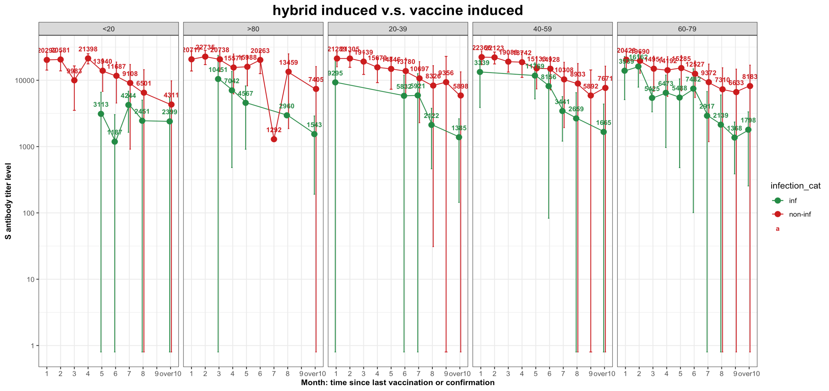
Make a four groups
Right order

Slide 16
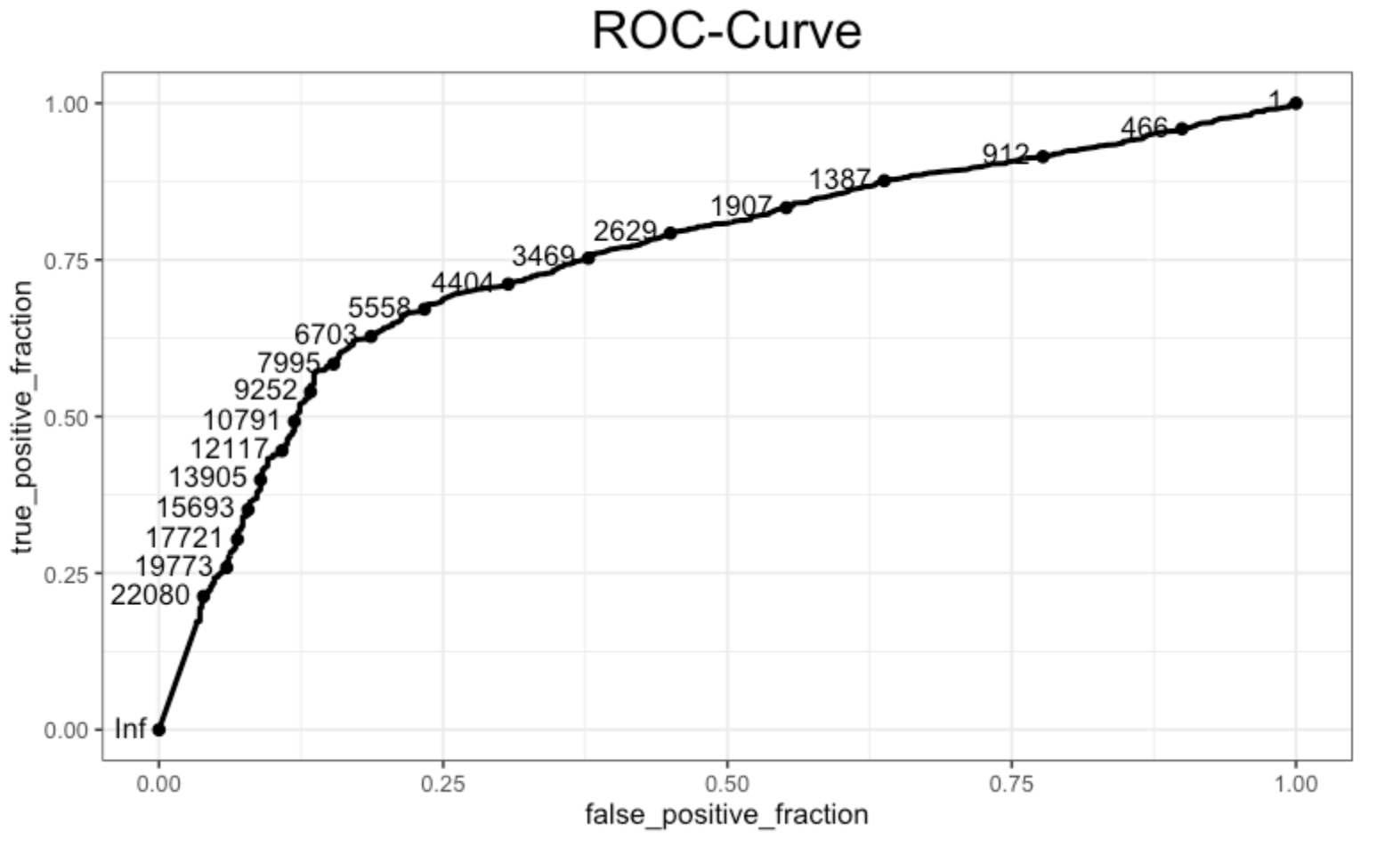

Slide 17
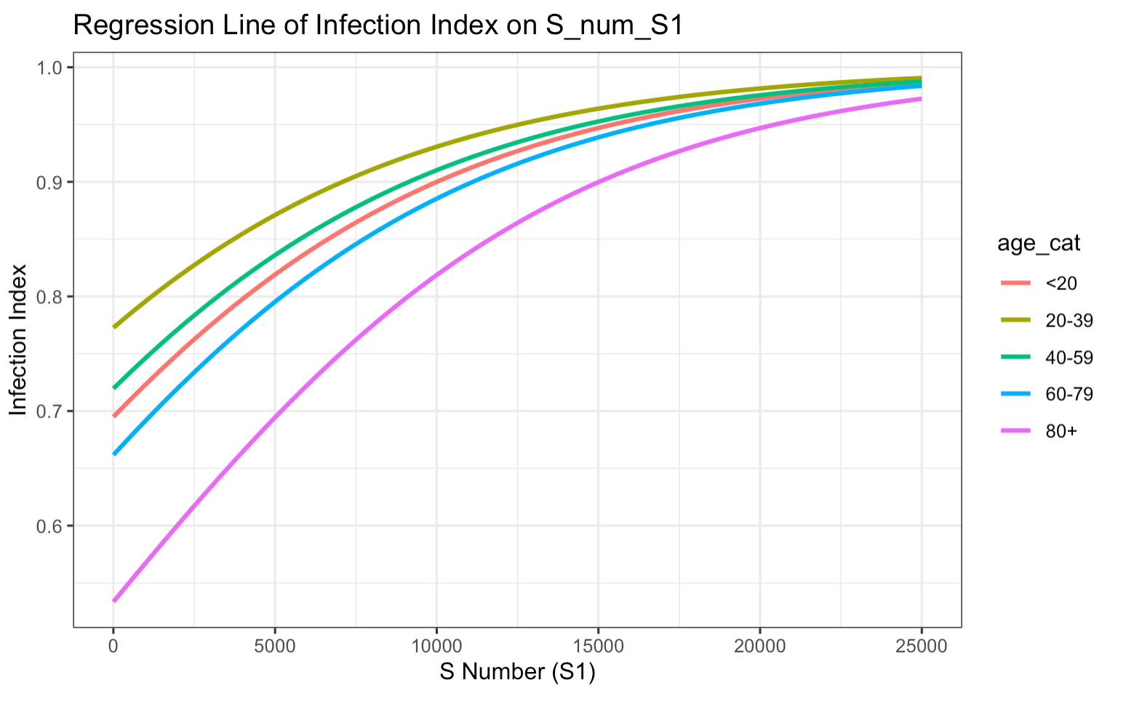
Regression Model Plot
Divide by
Vaccine and hybrid
Induced factor

Slide 18
Discussion
Summary:
Group I descriptive analysis indicated higher S antibody levels in uninfected individuals, and logistic regression showed that Spike (S) antibody thresholds for a 75% chance of avoiding COVID-19 infection are 6000, 8000, and 10000 for age groups <30, 30-60, and >60, respectively.
Group II analysis revealed there was no clear relationship between Spike antibody level and the severity of COVID-19 symptoms.
Population S antibody level threshold can guide appropriate vaccination interval by age group.
The association between S (spike) antibody levels and the severity of symptoms in individuals infected with COVID-19 shows a complex relationship between the immune response and disease outcomes→ While higher levels of S antibodies, especially those capable of neutralizing the virus, are generally associated with a more severe initial presentation of symptoms (Sancilio A et al, 2022), they may also indicate a more effective immune response.
Limitations:
Symptom levels can be a wide range but our study data is limited to binary information (Yes/No).
Spike antibody level can not explain the neutralizing antibody, which could be a better predictor for symptom severity.
Small sample size for those who are infected and asymptomatic individuals, making it difficult to prove a statistically significant difference.
Longer duration nof follow up on RR may be warranted.

Slide 19
Reference
[1] https://ourworldindata.org/covid-vaccinations
[2] Amjadi, M. F., & O'Connell, S. E. (2021). Specific COVID-19 symptoms correlate with high antibody levels against SARS-CoV-2. *AAI*.
[3] Imai, K., Kitagawa, Y., Tabata, S., Kubota, K., Nagura-Ikeda, M., Matsuoka, M., Miyoshi, K., Sakai, J., & all authors. (2021). Antibody response patterns in COVID-19 patients with different levels of disease severity in Japan. *Journal of Medical Virology*.
[4] Goldblatt, D., Fiore-Gartland, A., Johnson, M., Hunt, A., Bengt, C., Zavadska, D., Snipe, H. D., Brown, J. S., Workman, L., Zar, H. J., Montefiori, D., Shen, X., Dull, P., Plotkin, S., Siber, G., & Ambrosino, D. (2021). Towards a population-based threshold of protection for COVID-19 vaccines. *Vaccine*.

Slide 20
Appendix

Slide 21
Summary:
Group I descriptive analysis indicated higher S antibody levels in uninfected individuals, and logistic regression showed that Spike (S) antibody thresholds for a 75% chance of avoiding COVID-19 infection are 6000, 8000, and 10000 for age groups <30, 30-60, and >60, respectively.
Group II analysis revealed there was no clear relationship between Spike antibody level and the severity of COVID-19 symptom.
Compared to the study by Imai, K. and Kitagawa, Y., Japan 2021^{[3]}, our research focused on collecting Spike antibody levels from patients exhibiting a range of COVID-19 symptom severities. This approach, distinct from utilizing immobilized recombinant S protein, clarifies the link between anti-Spike antibodies, COVID-19 infection rates, and symptom severity.
Contrasting with the study conducted by David Goldblatt in 2022^{[4]}, our research establishes a protection threshold based on total anti-Spike antibody levels, as opposed to focusing solely on IgG. This approach offers a unique perspective in determining the protective correlate, providing a broader understanding of immunity.
Limitations:
The dataset shows that the group of confirmed infections identified between the first and second surveillance points, especially among asymptomatic individuals, is small, making it difficult to prove a statistically significant difference.
Future efforts should concentrate on integrating data from the third surveillance to enhance the cohort's comprehensiveness.

Slide 22
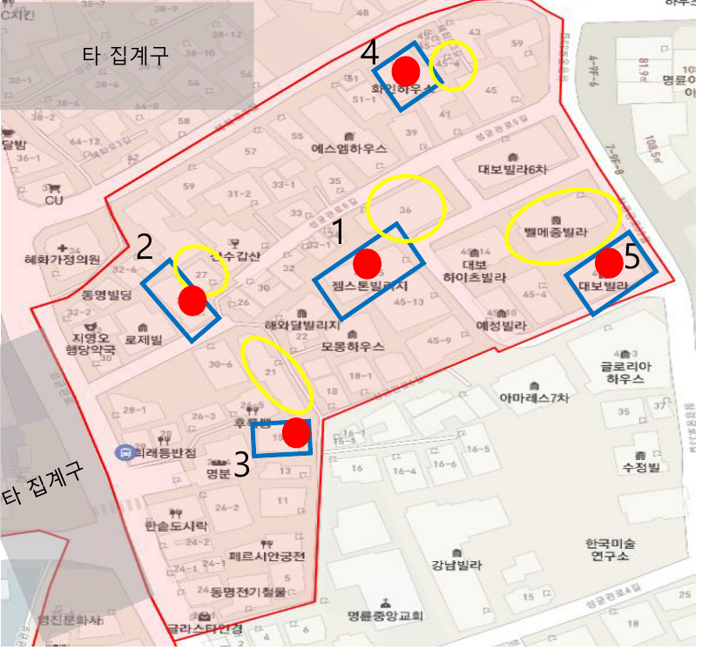
Selection criteria for main and reserve households in the aggregate premises
Aggregate Sphere
At least 2 assignments per region
(*Depends on the number of goals per region)
Main Furniture
Randomly selected by Global Research 5 Pattern Furniture
If this household declines consent or is unsuitable, spare furniture is designated in a counterclockwise spiral upon the surveyor's request, approved by the survey manager.
Spare Furniture

Slide 23
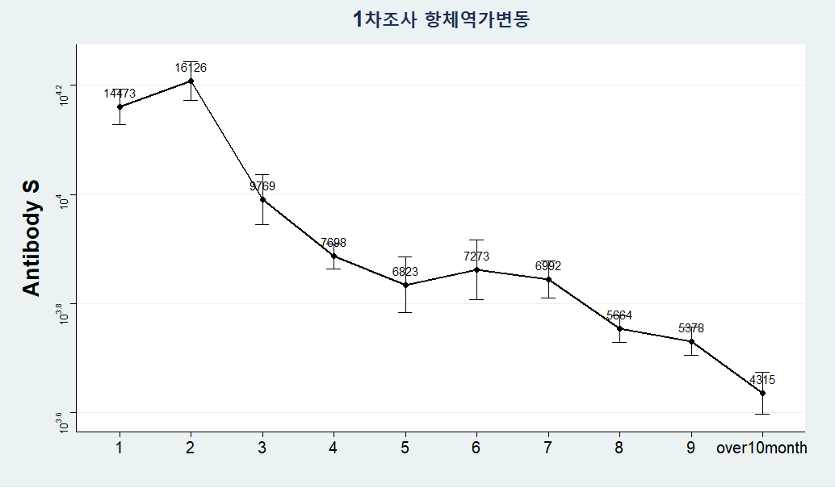
Trend of Decreased Antibody Titers Among Participants in the Follow-Up Survey (Total, 9,007 individuals)
Blood Collection Date – Last Vaccination Record or Date of Confirmation

Slide 24
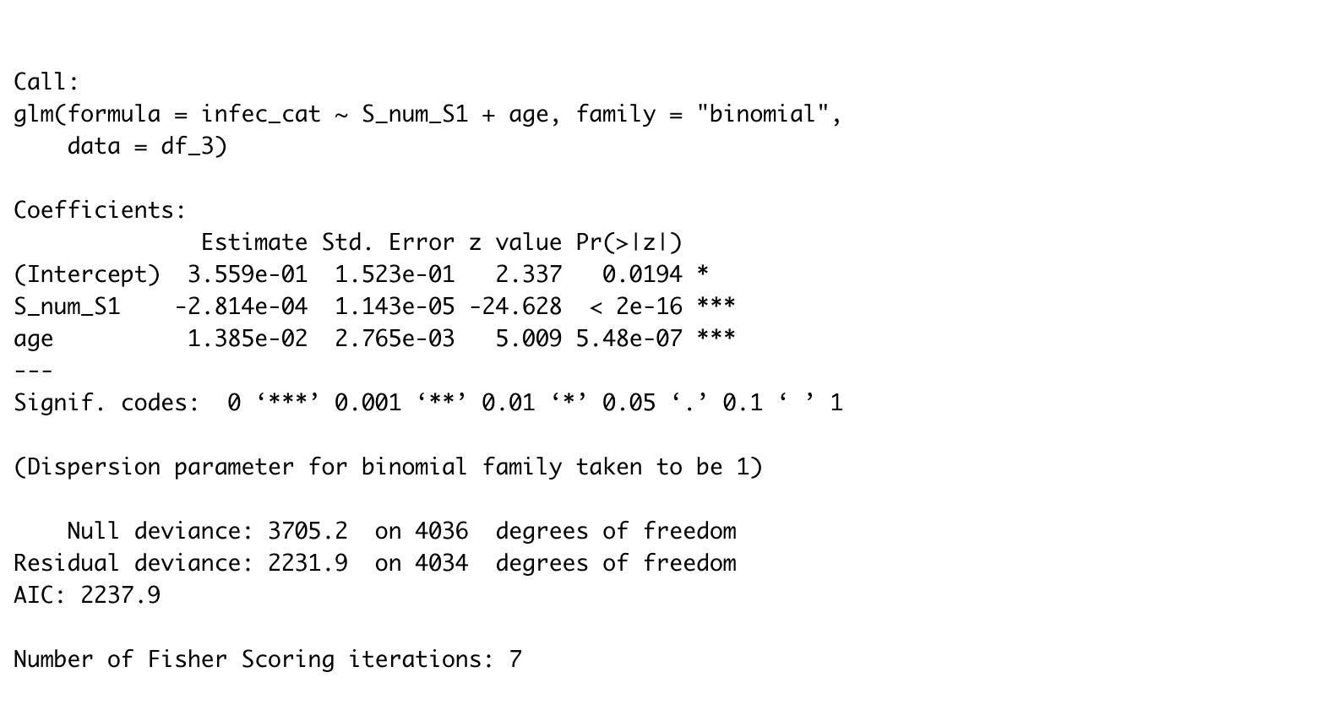
Regression Model
Both ”S_num_S1” and “age” are significant here

Slide 25
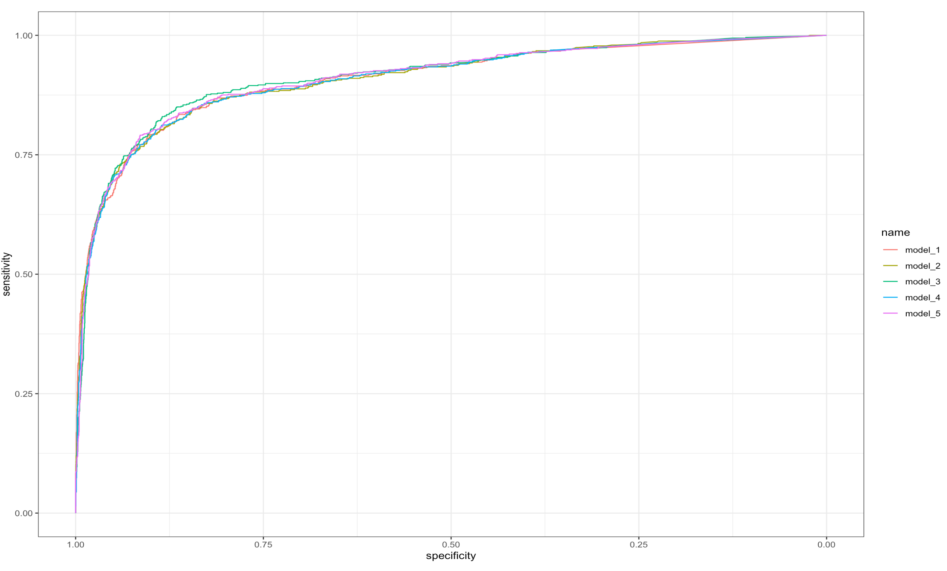
Regression Model comparison
Infec ~ S_num
Infec ~ S_num + Income
Infec ~ S_num + Age
Infec ~ S_num + Otherdisease
Infec ~ S_num + edu

Slide 26
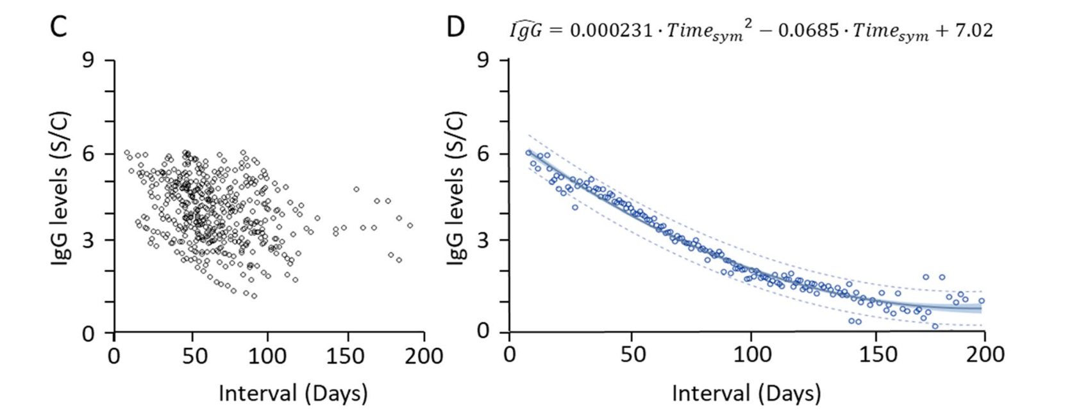
Topic: If S antibody level contribute to COVID-19 symptoms ?
What do we currently have ?
S Antibody Level
Symptomatic/Confirmed
Asymptomatic/Confirmed
UNKNOWN
with Decay
*
1st survey
2nd survey
contagion
V
vaccine
V
*
*
Date of latest vaccination
Date of Confirmation1
1) Date of Survey1
2) S Antibody level of Survey1
3) IF any Symptom before
Date of Confirmation2
1) Date of Survey2
2) S Antibody level of Survey2
3) IF any Symptom before
UNKNOWN
DOI: 10.1038/s41598-021-96171-4

Slide 27
DATA PREPROCESSING
S Antibody Level
Symptomatic/Confirmed
1st Case
Asymptomatic/Confirmed
V
vaccine
V
2nd Case
EXCLUDE
V
3rd Case
4th Case
EXCLUDE
V
5th Case
V
Aug 2022
1st survey
Dec 2022
2nd survey

Slide 28
Other cases needed to be carefully considered ?
1st Case
EXCLUDE
V
V
2nd Case
EXCLUDE
V
1st confirmation
- Symptomatic!
1st Survey
- IF any Symptom before?
- Yes
2nd confirmation
- Asymptomatic ?
- Symptomatic?
2nd Survey
- IF any Symptom before?
- Yes

